Slide 1
MATHEMATICS - XI
UNIT : II ALGEBRA
CHAPTER: 5 COMPLEX NUMBERS AND QUDRATIC EQUATIONS
SUB-TOPIC: ARGAND PLANE AND POLAR REPRESENTATION

Slide 2
Outline:
Argand Plane
Representation of Complex Number
in Argand Plane(Complex plane)
Polar representation of a
complex number
Examples
Assignment

Slide 3
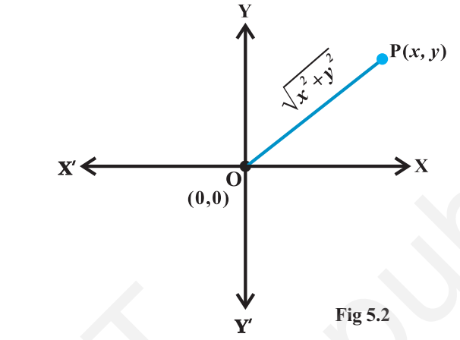
Argand plane and polar Representation
The plane having a complex number assigned to each of its point is called the complex plane or the Argand plane
z (x+iy)
The x-axis and y-axis in the Argand plane are called, respectively, the real axis and the imaginary axis

Slide 4
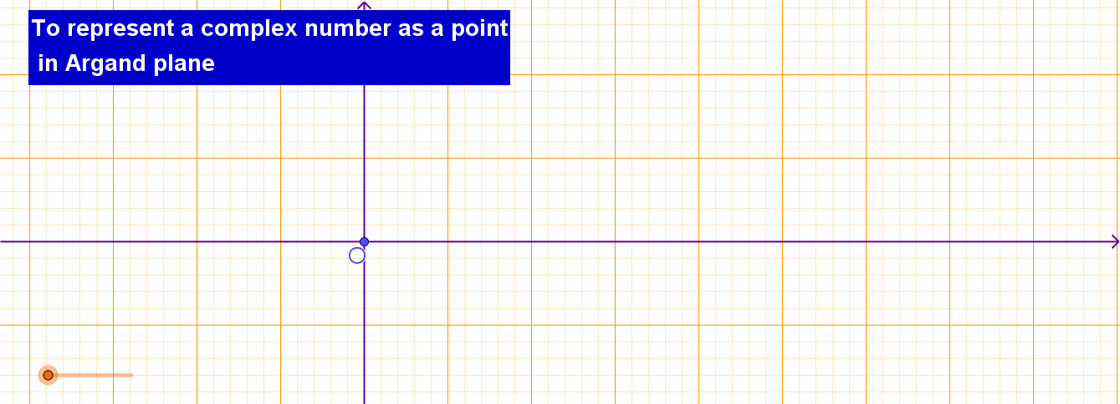
To represent complex number as a point in Argand plane
z = 2 + i
In Argand plane (2,1) represents the complex number z = 2 + i

Slide 5
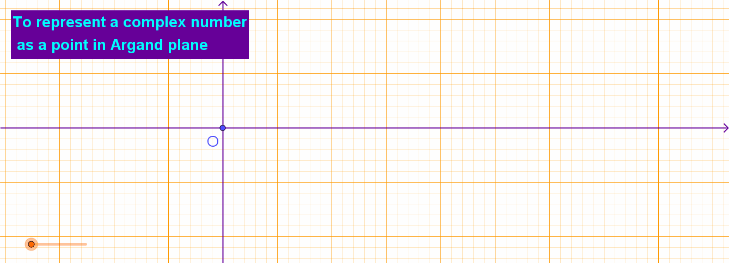
To represent complex number as a point in Argand plane
z = 1 - i
In Argand plane (1 , -1) represents the complex number z = 1- i

Slide 6
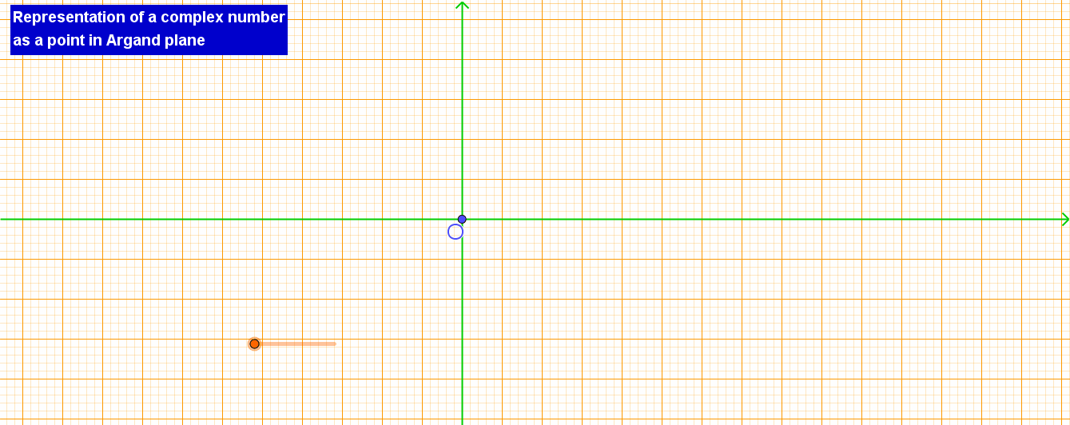
To represent complex number as a point in Argand plane
z = 4 =4 + i0
In Argand plane (4 , 0) represents the complex number z = 4 +0 i

Slide 7
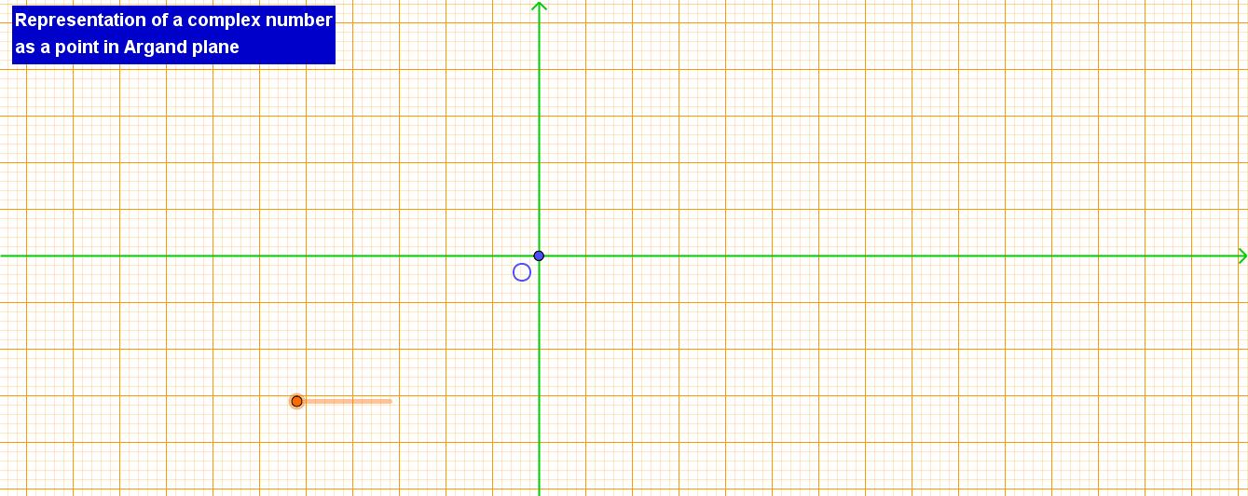
To represent complex number as a point in Argand plane
z = 3i = 0 +3 i
In Argand plane (0 , 3) represents the complex number z = 0 +3 i

Slide 8
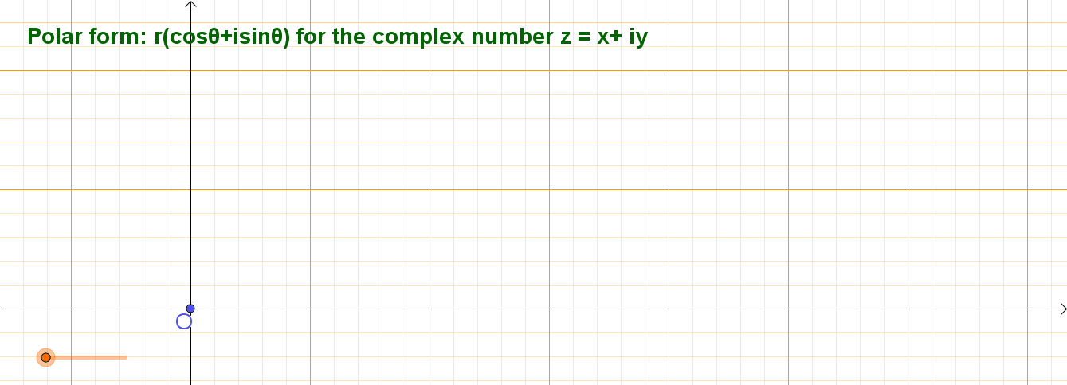
Polar form of the complex number z =$x+iy$
Let the point C represent the nonzero complex number z = x + iy. Let the directed line segment OC be of length r and $θ$ be the angle which OC makes with the positive direction of x-axis

Slide 9
Polar form of the complex number z =$x+iy$
The point P is uniquely determined by the ordered pair of real numbers (r, $θ$), called the polar coordinates of the point P

Slide 10
Polar form of z =$1+i√3$
Represent the complex number z = 1+ i $√$3 in the polar form
$$Let 1=rcosθ and \sqrt{3}=rsinθ$$
By squaring and adding we get $r^{2}(\cos^{2}{θ+\sin^{2}{θ)=4}}$
$⇒$r = 2
$$Therefore cosθ=\frac{1}{2},sinθ=\frac{√3}{2}which gives θ=\frac{π}{3}$$
$$Therefore required polar form is z=2(cos\frac{π}{3}+isin\frac{π}{3})$$

Slide 11
Polar form of z =$1+i√3$

Slide 12
Assignment
Find the modulus and the arguments of each of the complex numbers (i) $−1−i\sqrt{3}$ (ii) $−\sqrt{3}+i$
Convert each of the complex numbers (i) $1−i \left(ii\right) i$
Represent the complex number $z=1+i√3$ in the polar form
Convert the complex number into polar form
Represent the complex number
in the form x+iy

